Slide 1

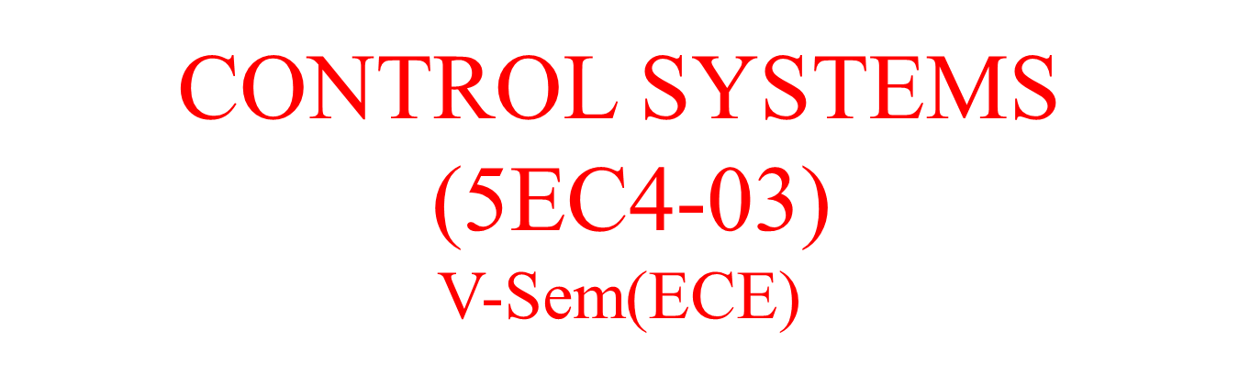

Slide 2
Course Outcomes
CO1: Characterize a system mathematically and find its steady state behaviour
CO2: Analyze stability of a system using different tests
CO3: Design various controllers
CO4: Solve linear, non-linear and optimal complex control problems
CO5: Designing state model for a given system of equations

Slide 3
Disclaimer
The contents used in this presentation are taken from the text books mentioned in the references. I do not hold any copyrights for the contents. It has been prepared to use in the class lectures, not for commercial purpose.

Slide 4
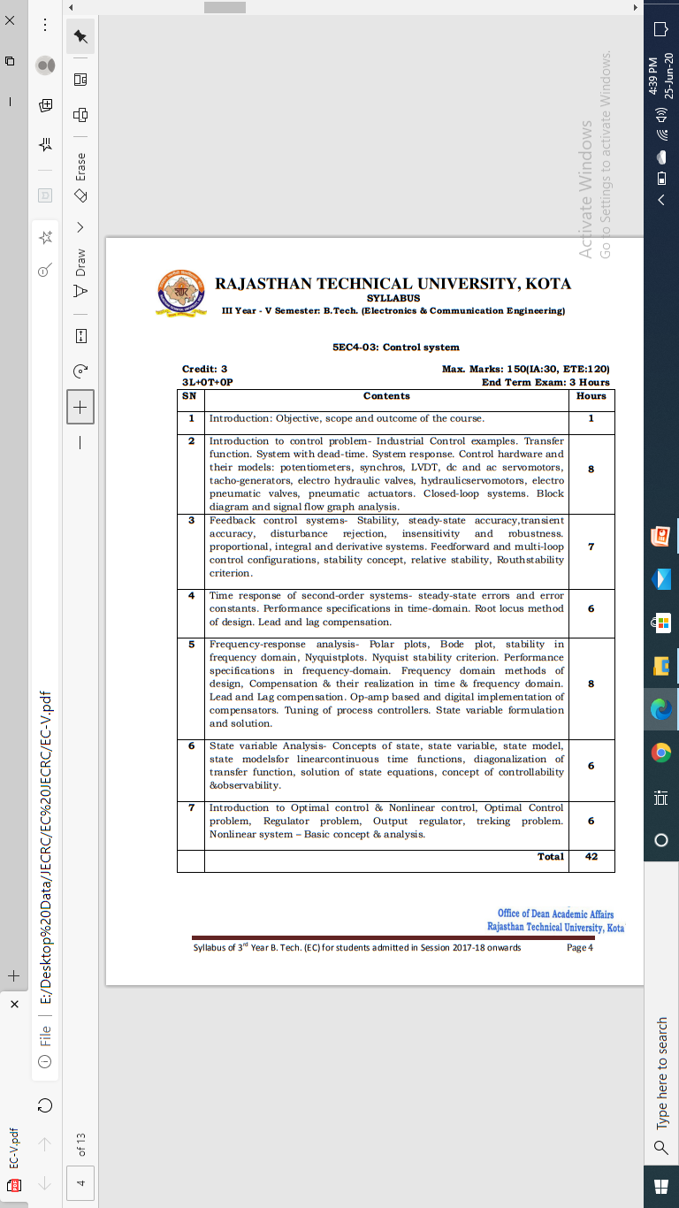
Syllabus

Slide 5
UNIT-III

Slide 6
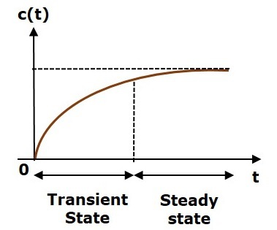
What is Time Response?
If the output of control system for an input varies with respect to time, then it is called the time response of the control system. The time response consists of two parts.
Transient response
Steady state response
The response of control system in time domain is shown in the following figure.

Slide 7
Here, both the transient and the steady states are indicated in the figure. The responses corresponding to these states are known as transient and steady state responses.
Mathematically, we can write the time response c(t) as
c(t)=ctr(t)+css(t)
Where,
c_{tr}(t) is the transient response
c_{ss}(t) is the steady state response

Slide 8

Transient Response
After applying input to the control system, output takes certain time to reach steady state. So, the output will be in transient state till it goes to a steady state. Therefore, the response of the control system during the transient state is known as transient response.
The transient response will be zero for large values of ‘t’. Ideally, this value of ‘t’ is infinity and practically, it is five times constant.
Mathematically, we can write it as

Slide 9

Steady state Response
The part of the time response that remains even after the transient response has zero value for large values of ‘t’ is known as steady state response. This means, the transient response will be zero even during the steady state.
Example
Let us find the transient and steady state terms of the time response of the control system
Here, the second term 5^e−t will be zero as t denotes infinity. So, this is the transient term. And the first term 10 remains even as t approaches infinity. So, this is the steady state term.

Slide 10
Standard Test Signals
The standard test signals are impulse, step, ramp and parabolic. These signals are used to know the performance of the control systems using time response of the output.

Slide 11
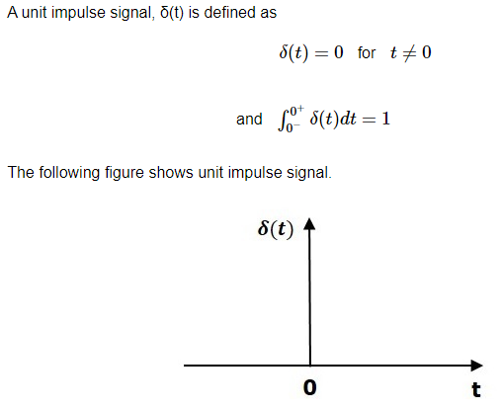
Unit Impulse Signal
So, the unit impulse signal exists only at ‘t’ is equal to zero. The area of this signal under small interval of time around ‘t’ is equal to zero is one. The value of unit impulse signal is zero for all other values of ‘t’.

Slide 12
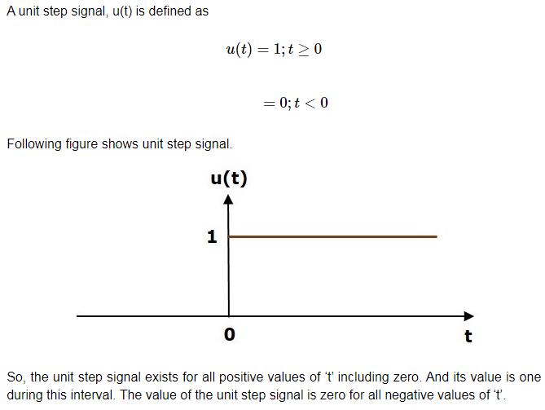
Unit Step Signal

Slide 13
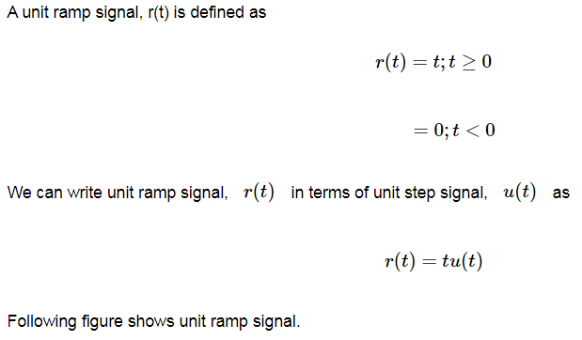
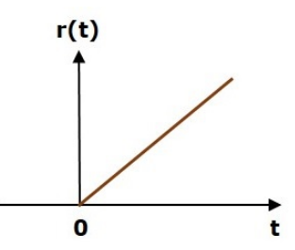
Unit Ramp Signal
So, the unit ramp signal exists for all positive values of ‘t’ including zero. And its value increases linearly with respect to ‘t’ during this interval. The value of unit ramp signal is zero for all negative values of ‘t’.

Slide 14
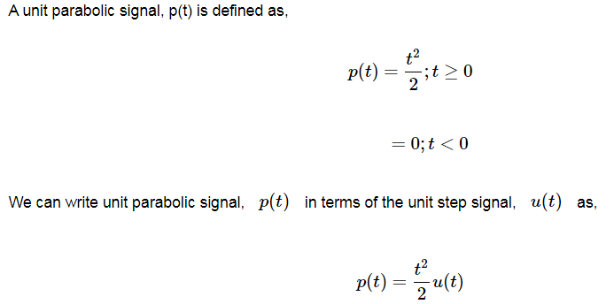
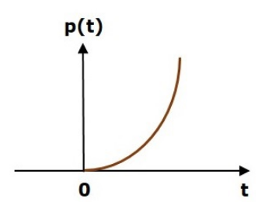
Unit Parabolic Signal
So, the unit parabolic signal exists for all the positive values of ‘t’ including zero. And its value increases non-linearly with respect to ‘t’ during this interval. The value of the unit parabolic signal is zero for all the negative values of ‘t’.

Slide 15
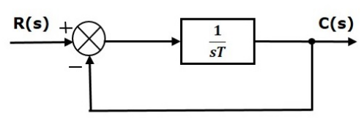

Response of the First Order System
Let us discuss the time response of the first order system. Consider the following block diagram of the closed loop control system. Here, an open loop transfer function, 1/sT is connected with a unity negative feedback.
We know that the transfer function of the closed loop control system has unity negative feedback as,
Substitute, G(s)=1/sT in the above equation.

Slide 16


The power of s is one in the denominator term. Hence, the above transfer function is of the first order and the system is said to be the first order system.
We can re-write the above equation as
Where,
C(s) is the Laplace transform of the output signal c(t),
R(s) is the Laplace transform of the input signal r(t), and
T is the time constant.
Follow these steps to get the response (output) of the first order system in the time domain.

Slide 17


Take the Laplace transform of the input signal
Consider the equation,
Substitute R(s) value in the above equation.
Do partial fractions of C(s) if required.
Apply inverse Laplace transform to C(s).
We have seen the standard test signals like impulse, step, ramp and parabolic. Let us now find out the responses of the first order system for each input, one by one. The name of the response is given as per the name of the input signal. For example, the response of the system for an impulse input is called as impulse response.

Slide 18



Impulse Response of First Order System
Consider the unit impulse signal as an input to the first order system. So,
Apply Laplace transform on both the sides.
Consider the equation, C(s)=(1/sT+1)R(s)
Substitute, R(s)=1 in the above equation.
Rearrange the above equation in one of the standard forms of Laplace transforms.
Apply inverse Laplace transform on both sides.
r(t)=δ(t)
R(s)=1

Slide 19
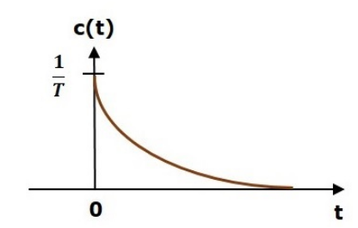
The unit impulse response is shown in the following figure.
The unit impulse response, c(t) is an exponential decaying signal for positive values of ‘t’ and it is zero for negative values of ‘t’.

Slide 20


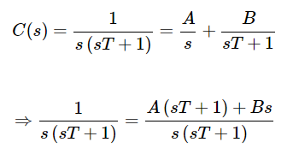
Step Response of First Order System
Consider the unit step signal as an input to first order system.
So, r(t)=u(t)
Apply Laplace transform on both the sides. R(s)=1/s
Consider the equation,
Substitute, R(s)=1/s in the above equation.
Do partial fractions of C(s).

Slide 21
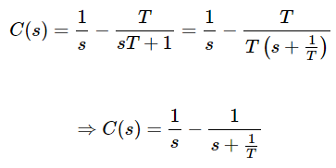
On both the sides, the denominator term is the same. So, they will get cancelled by each other. Hence, equate the numerator terms.
1=A(sT+1)+Bs
By equating the constant terms on both the sides, you will get A = 1.
Substitute, A = 1 and equate the coefficient of the s terms on both the sides.
0=T+B⇒B=−T
Substitute, A = 1 and B = −T in partial fraction expansion of C(s).

Slide 22




Apply inverse Laplace transform on both the sides.
The unit step response, c(t) has both the transient and the steady state terms.
The transient term in the unit step response is -
The steady state term in the unit step response is -

Slide 23
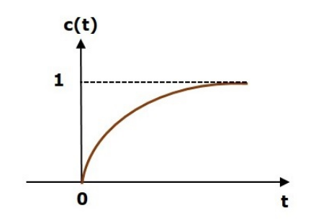
The following figure shows the unit step response.
The value of the unit step response, c(t) is zero at t = 0 and for all negative values of t.
It is gradually increasing from zero value and finally reaches to one in steady state. So, the steady state value depends on the magnitude of the input.

Slide 24




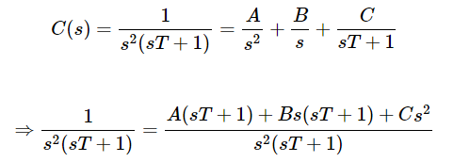
Ramp Response of First Order System
Consider the unit ramp signal as an input to the first order system.
So, r(t)=tu(t)
Apply Laplace transform on both the sides.
Consider the equation,
Substitute, in the above equation.
Do partial fractions of C(s)

Slide 25


On both the sides, the denominator term is the same. So, they will get cancelled by each other. Hence, equate the numerator terms.
By equating the constant terms on both the sides, you will get A = 1.
Substitute, A = 1 and equate the coefficient of the s terms on both the sides.
0=T+B⇒B=−T
Similarly, substitute B = −T and equate the coefficient of s2 terms on both the sides. You will get .
Substitute A = 1, B = −T and C=T2 in the partial fraction expansion of C(s).

Slide 26
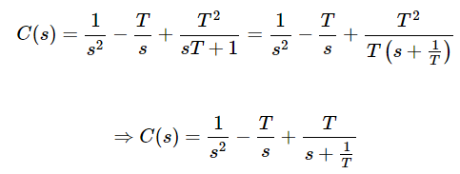



Apply inverse Laplace transform on both the sides.
The unit ramp response, c(t) has both the transient and the steady state terms.
The transient term in the unit ramp response is -
The steady state term in the unit ramp response is -

Slide 27
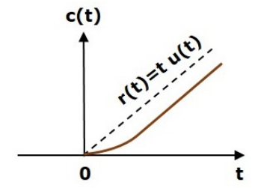
The following figure shows the unit ramp response.
The unit ramp response, c(t) follows the unit ramp input signal for all positive values of t. But, there is a deviation of T units from the input signal.

Slide 28






Parabolic Response of First Order System
Consider the unit parabolic signal as an input to the first order system.
So,
Apply Laplace transform on both the sides.
Consider the equation,
Substitute in the above equation.
Do partial fractions of C(s)

Slide 29



After simplifying, you will get the values of A, B, C and D as 1, −T, T^2 and T^3 respectively. Substitute these values in the above partial fraction expansion of C(s).
Apply inverse Laplace transform on both the sides.
The unit parabolic response, c(t) has both the transient and the steady state terms.

Slide 30

The steady state term in the unit parabolic response is
From these responses, we can conclude that the first order control systems are not stable with the ramp and parabolic inputs because these responses go on increasing even at infinite amount of time.
The first order control systems are stable with impulse and step inputs because these responses have bounded output.
But, the impulse response doesn’t have steady state term. So, the step signal is widely used in the time domain for analyzing the control systems from their responses.

Slide 31

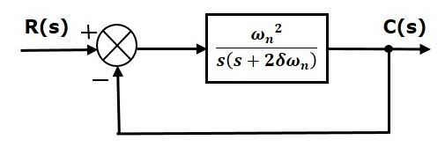


Response of Second Order System
In this chapter, let us discuss the time response of second order system. Consider the following block diagram of closed loop control system. Here, an open loop transfer function, is connected with a unity negative feedback.
We know that the transfer function of the closed loop control system having unity negative feedback as
Substitute, in the above equation.

Slide 32
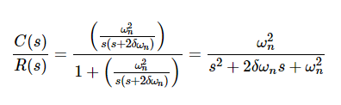

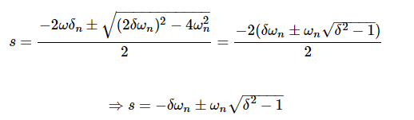
The power of ‘s’ is two in the denominator term. Hence, the above transfer function is of the second order and the system is said to be the second order system.
The characteristic equation is –
The roots of characteristic equation are –
The two roots are imaginary when δ = 0.
The two roots are real and equal when δ = 1.
The two roots are real but not equal when δ > 1.
The two roots are complex conjugate when 0 < δ < 1.

Slide 33


We can write C(s)equation as,
Where,
C(s) is the Laplace transform of the output signal, c(t)
R(s) is the Laplace transform of the input signal, r(t)
ω_{n} is the natural frequency
δ is the damping ratio.
Follow these steps to get the response (output) of the second order system in the time domain.
Take Laplace transform of the input signal, r(t).
Consider the equation,
Substitute R(s)value in the above equation.
Do partial fractions of C(s) if required.
Apply inverse Laplace transform to C(s).

Slide 34


Step Response of Second Order System
Consider the unit step signal as an input to the second order system.
Laplace transform of the unit step signal is,
We know the transfer function of the second order closed loop control system is,

Slide 35
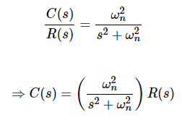


Case 1: δ = 0
Substitute, R(s)=1/s in the above equation.
Apply inverse Laplace transform on both the sides.
So, the unit step response of the second order system when delta=0 will be a continuous time signal with constant amplitude and frequency.

Slide 36
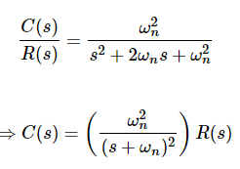




Case 2: δ = 1
Substitute, R(s)=1/s in the above equation.
Do partial fractions of C(s).
After simplifying, you will get the values of A, B and C as 1,−1and −ωn respectively. Substitute these values in the above partial fraction expansion of C(s).
Apply inverse Laplace transform on both the sides.
So, the unit step response of the second order system will try to reach the step input in steady state.

Slide 37
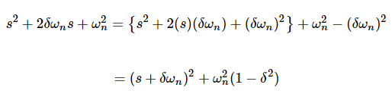
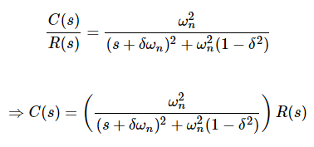
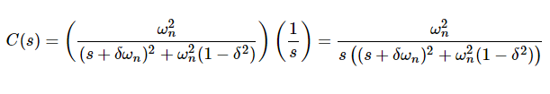

Case 3: 0 < δ < 1
We can modify the denominator term of the transfer function as follows −
The transfer function becomes,
Substitute, R(s)=1/s in the
above equation. Do partial
Fractions.

Slide 38
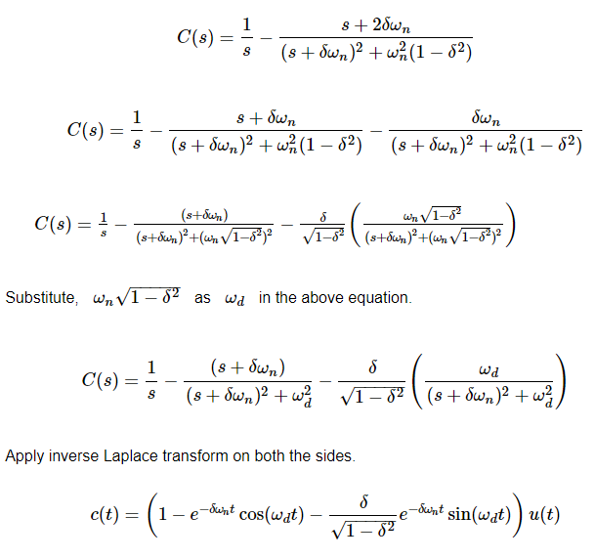
After simplifying, you will get the values of A, B and C as 1,−1and−2δωn ,respectively. Substitute these values in the above partial fraction expansion of C(s).

Slide 39
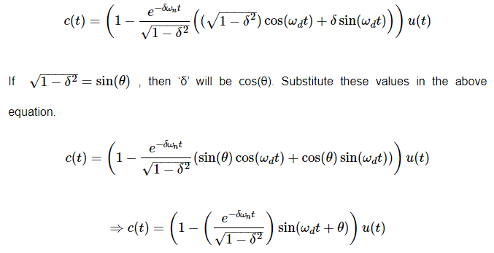
So, the unit step response of the second order system is having damped oscillations (decreasing amplitude) when ‘δ’ lies between zero and one.

Slide 40
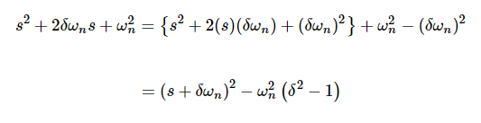
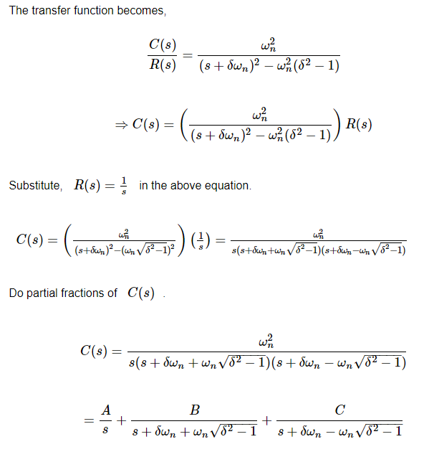
Case 4: δ > 1
We can modify the denominator term of the transfer function as follows −

Slide 41
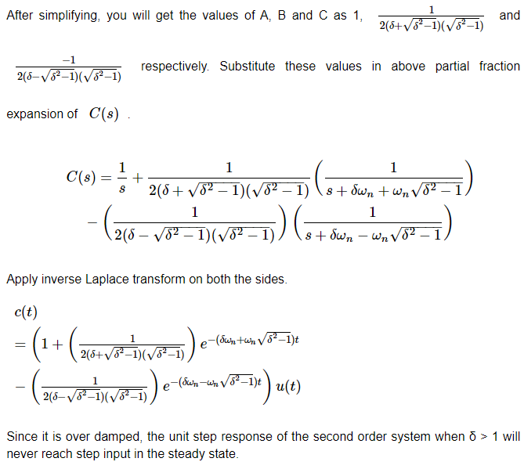

Slide 42
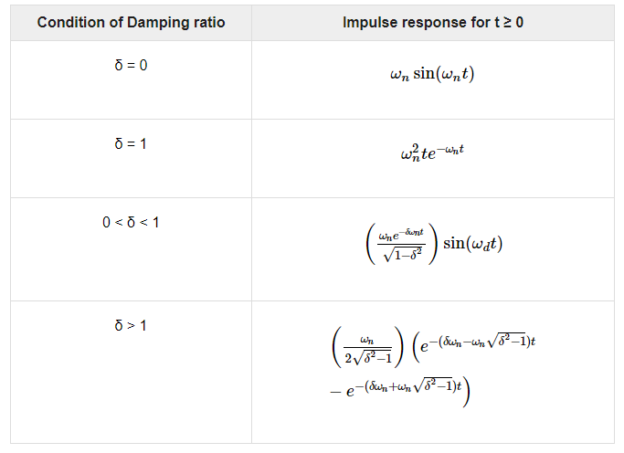
Impulse Response of Second Order System
The impulse response of the second order system can be obtained by using any one of these two methods.
Follow the procedure involved while deriving step response by considering the value of R(s) as 1 instead of 1s.
Do the differentiation of the step response.
The following table shows the impulse response of the second order system for 4 cases of the damping ratio.

Slide 43
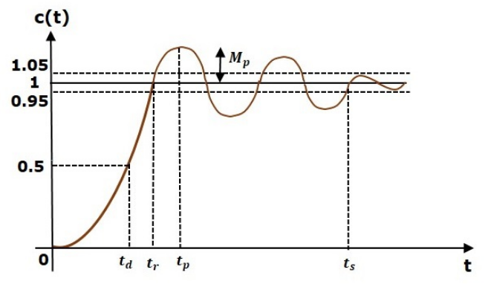
In this chapter, let us discuss the time domain specifications of the second order system. The step response of the second order system for the under damped case is shown in the following figure.
All the time domain specifications are represented in this figure. The response up to the settling time is known as transient response and the response after the settling time is known as steady state response.

Slide 44

Delay Time
It is the time required for the response to reach half of its final value from the zero instant. It is denoted by td.
Consider the step response of the second order system for t ≥ 0, when ‘δ’ lies between zero and one.
The final value of the step response is one.
Therefore, at t=td, the value of the step response will be 0.5. Substitute, these values in the above equation.

Slide 45
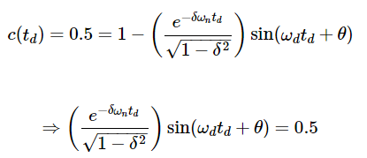

By using linear approximation, you will get the delay time t_{d} as

Slide 46
Rise Time
It is the time required for the response to rise from 0% to 100% of its final value. This is applicable for the under-damped systems. For the over-damped systems, consider the duration from 10% to 90% of the final value. Rise time is denoted by t_{r}.
At t = t₁ = 0, c(t) = 0.
We know that the final value of the step response is one.
Therefore, at t=t2, the value of step response is one. Substitute, these values in the following equation.

Slide 47
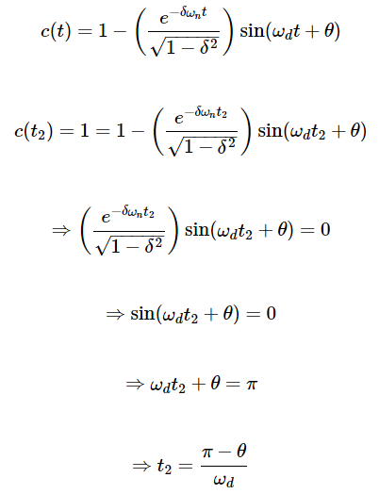

Slide 48
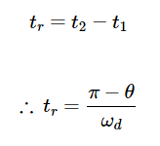
Substitute t₁ and t₂ values in the following equation of rise time,
From above equation, we can conclude that the rise time tr and the damped frequency ωd are inversely proportional to each other.

Slide 49
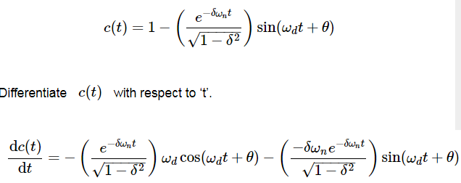
Peak Time
It is the time required for the response to reach the peak value for the first time. It is denoted by tp. At t=tp, the first derivate of the response is zero.
We know the step response of second order system for under-damped case is

Slide 50
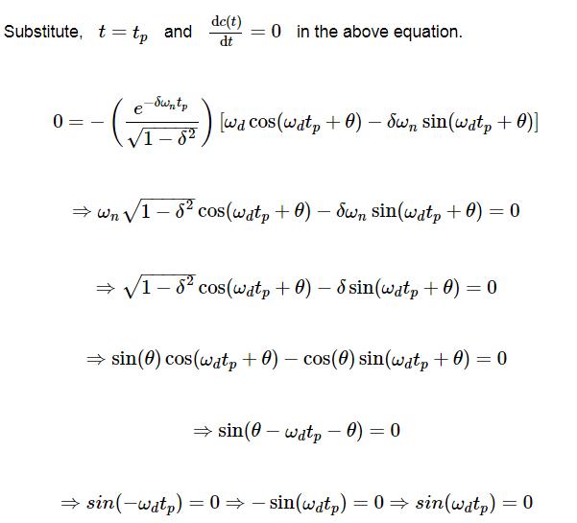
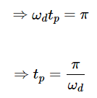

Slide 51

Peak Overshoot
Peak overshoot M_{p} is defined as the deviation of the response at peak time from the final value of response. It is also called the maximum overshoot.
Mathematically, we can write it as
Mp=c(tp)−c(∞)
Where,
c(t_{p}) is the peak value of the response.
c(∞) is the final (steady state) value of the response.
At t=tp, the response c(t) is -

Slide 52
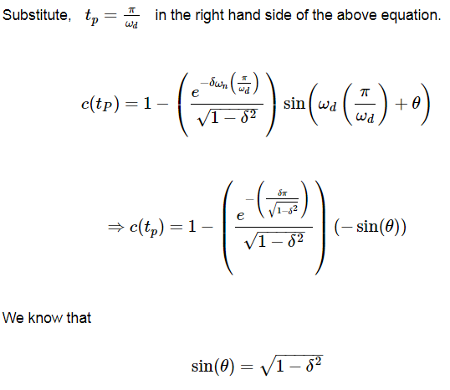
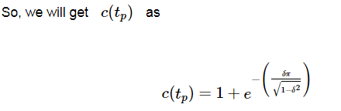

Slide 53
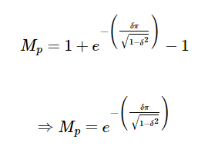

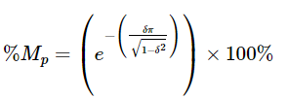
Substitute the values of c(tp) and c(∞) in the peak overshoot equation.
Percentage of peak overshoot % Mp can be calculated by using this formula.
By substituting the values of Mp and c(∞) in above formula, we will get the Percentage of the peak overshoot %Mp as

Slide 54


Settling time
It is the time required for the response to reach the steady state and stay within the specified tolerance bands around the final value. In general, the tolerance bands are 2% and 5%. The settling time is denoted by ts.
The settling time for 5% tolerance band is –
The settling time for 2% tolerance band is -

Slide 55
Where, τ is the time constant and is equal to 1/δωn.
Both the settling time ts and the time constant τ are inversely proportional to the damping ratio δ.
Both the settling time ts and the time constant τ are independent of the system gain. That means even the system gain changes, the settling time ts and time constant τ will never change.

Slide 56



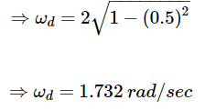
Example Let us now find the time domain specifications of a control system having the closed loop transfer function when the unit step signal is applied as an input to this control system.
We know that the standard form of the transfer function of the second order closed loop control system as
By equating these two transfer functions, we will get the undamped natural frequency ωn as 2 rad/sec and the damping ratio δ as 0.5.
We know the formula for damped frequency ωd as
Substitute, ωn and δ values in the above formula.

Slide 57
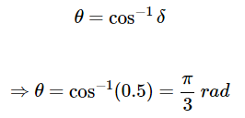
Substitute, δ value in following relation
Substitute the above necessary values in the formula of each time domain specification and simplify in order to get the values of time domain specifications for given transfer function.
The following table shows the formulae of time domain specifications, substitution of necessary values and the final values.

Slide 58
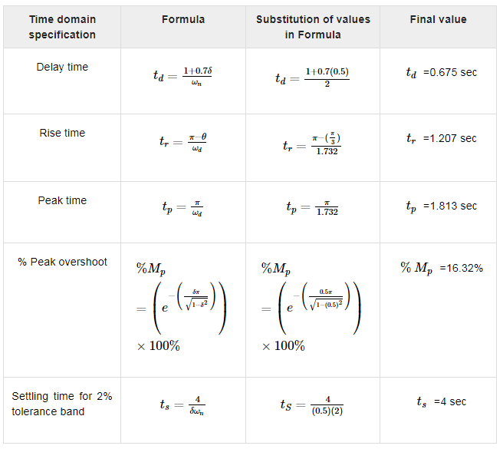

Slide 59

Control Systems - Steady State Errors
The deviation of the output of control system from desired response during steady state is known as steady state error. It is represented as ess. We can find steady state error using the final value theorem as follows.
Where,
E(s) is the Laplace transform of the error signal, e(t)
Let us discuss how to find steady state errors for unity feedback and non-unity feedback control systems one by one.

Slide 60
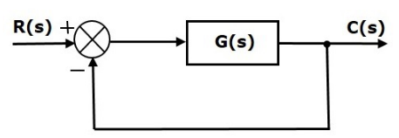
Steady State Errors for Unity Feedback Systems
Consider the following block diagram of closed loop control system, which is having unity negative feedback.
Where,
R(s) is the Laplace transform of the reference Input signal r(t)
C(s) is the Laplace transform of the output signal c(t)

Slide 61
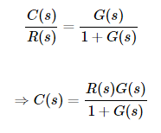
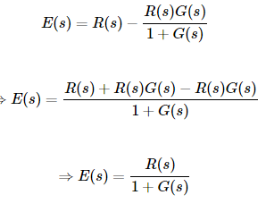

We know the transfer function of the unity negative feedback closed loop control system as
The output of the summing point is –
E(s)=R(s)−C(s)
Substitute C(s) value in the above equation
Substitute E(s) value in the steady state
error formula.

Slide 62
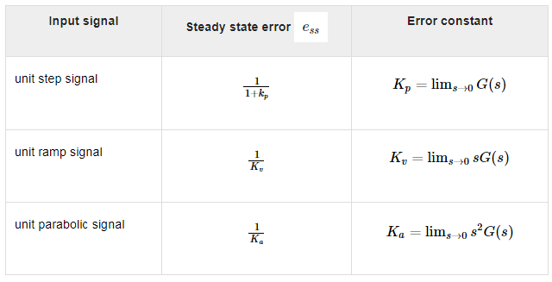
The following table shows the steady state errors and the error constants for standard input signals like unit step, unit ramp & unit parabolic signals.
Where, Kp, Kv and Ka are position error constant, velocity error constant and acceleration error constant respectively.

Slide 63
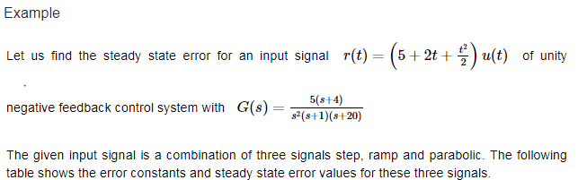


We will get the overall steady state error, by adding the above three steady state errors.
Therefore, we got the steady state error ess as 1 for this example.

Slide 64


Steady State Errors for Non-Unity Feedback Systems
Consider the following block diagram of closed loop control system, which is having non unity negative feedback.
We can find the steady state errors only for the unity feedback systems. So, we have to convert the non-unity feedback system into unity feedback system. For this, include one unity positive feedback path and one unity negative feedback path in the above block diagram. The new block diagram looks like as shown below.

Slide 65

Simplify the above block diagram by keeping the unity negative feedback as it is. The following is the simplified block diagram.
This block diagram resembles the block diagram of the unity negative feedback closed loop control system. Here, the single block is having the transfer function G(s)/1+G(s)H(s)−G(s) instead of G(s). You can now calculate the steady state errors by using steady state error formula given for the unity negative feedback systems.
Note − It is meaningless to find the steady state errors for unstable closed loop systems. So, we have to calculate the steady state errors only for closed loop stable systems. This means we need to check whether the control system is stable or not before finding the steady state errors. In the next chapter, we will discuss the concepts-related stability.

Slide 66

What is Stability?
A system is said to be stable, if its output is under control. Otherwise, it is said to be unstable. A stable system produces a bounded output for a given bounded input.
The following figure shows the response of a stable system.
This is the response of first order control system for unit step input. This response has the values between 0 and 1. So, it is bounded output. We know that the unit step signal has the value of one for all positive values of t including zero. So, it is bounded input. Therefore, the first order control system is stable since both the input and the output are bounded.

Slide 67
Types of Systems based on Stability
We can classify the systems based on stability as follows.
Absolutely stable system
Conditionally stable system
Marginally stable system
Absolutely Stable System
If the system is stable for all the range of system component values, then it is known as the absolutely stable system. The open loop control system is absolutely stable if all the poles of the open loop transfer function present in left half of ‘s’ plane. Similarly, the closed loop control system is absolutely stable if all the poles of the closed loop transfer function present in the left half of the ‘s’ plane.

Slide 68
Conditionally Stable System
If the system is stable for a certain range of system component values, then it is known as conditionally stable system.
Marginally Stable System
If the system is stable by producing an output signal with constant amplitude and constant frequency of oscillations for bounded input, then it is known as marginally stable system. The open loop control system is marginally stable if any two poles of the open loop transfer function is present on the imaginary axis. Similarly, the closed loop control system is marginally stable if any two poles of the closed loop transfer function is present on the imaginary axis.

Slide 69
REFERENCES
Effect of Feedback and Stability (U.K Bhakshi & S.C Goyal “Feedback Control System” Technical Publication, Pune).
Numerical of Stability (Norman S. Nise “Control System Engineering” Wiley Eastern).
Automatic Control Systems (With Matlab Programs) : S. Hasan Saeed
Control Systems Engineering By I.L.Nagrath

Slide 70
Thank You

